Slide 1


INFO 6105 --- Final Project PPT
Credit Card Fraud Detection
By Xuhang Liu

Slide 2
CONTENT
公众账号基本信息介绍
Dataset
Conclusion
图文信息统计分析
1
2
3
4
商业软文信息统计分析
Problem Statement
Methodology
总结

Slide 3
1
Credit Card Fraud Detection
Problem Statement
Final Project Overview

Slide 4
Final Project Overview -- Problem Statement
Banks, merchants and credit card processors companies lose billions of dollars every year to credit card fraud.
Todays information on internet: better security, interactivity and trackability
Detection:
A
Credit card companies should able to recognize fraudulent credit card transactions
B
With help of machine learning models
C
Unfeasible due to huge amounts of data and its complexity
D
It took police forces a few months before identifying the criminals

Slide 5
2
Credit Card Fraud Detection
Dataset

Slide 6

Dataset
Fraud detection dataset includes:
Transactions made by credit cards in September 2013 by European cardholders
Contains only numerical input variables which are the result of a PCA transformation
Not provided the original features and more background information

Slide 7
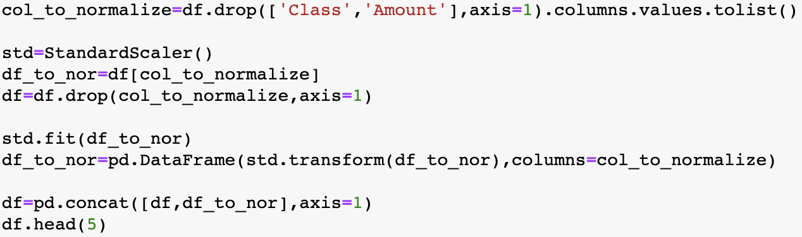
Data processing
Features V1, V2, ... V28 are the principal components obtained with PCA
The only features which have not been transformed with PCA are Time and Amount. Feature Time contains the seconds elapsed between each transaction and the first transaction in the dataset. The feature Amount is the transaction Amount, this feature can be used for example-dependent cost-sensitive learning.
Feature Class is the response variable and it takes value 1 in case of fraud and 0 otherwise.
Scale the data except class and account

Slide 8
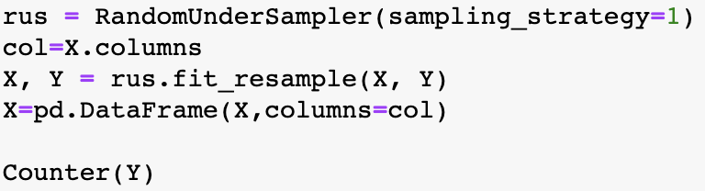
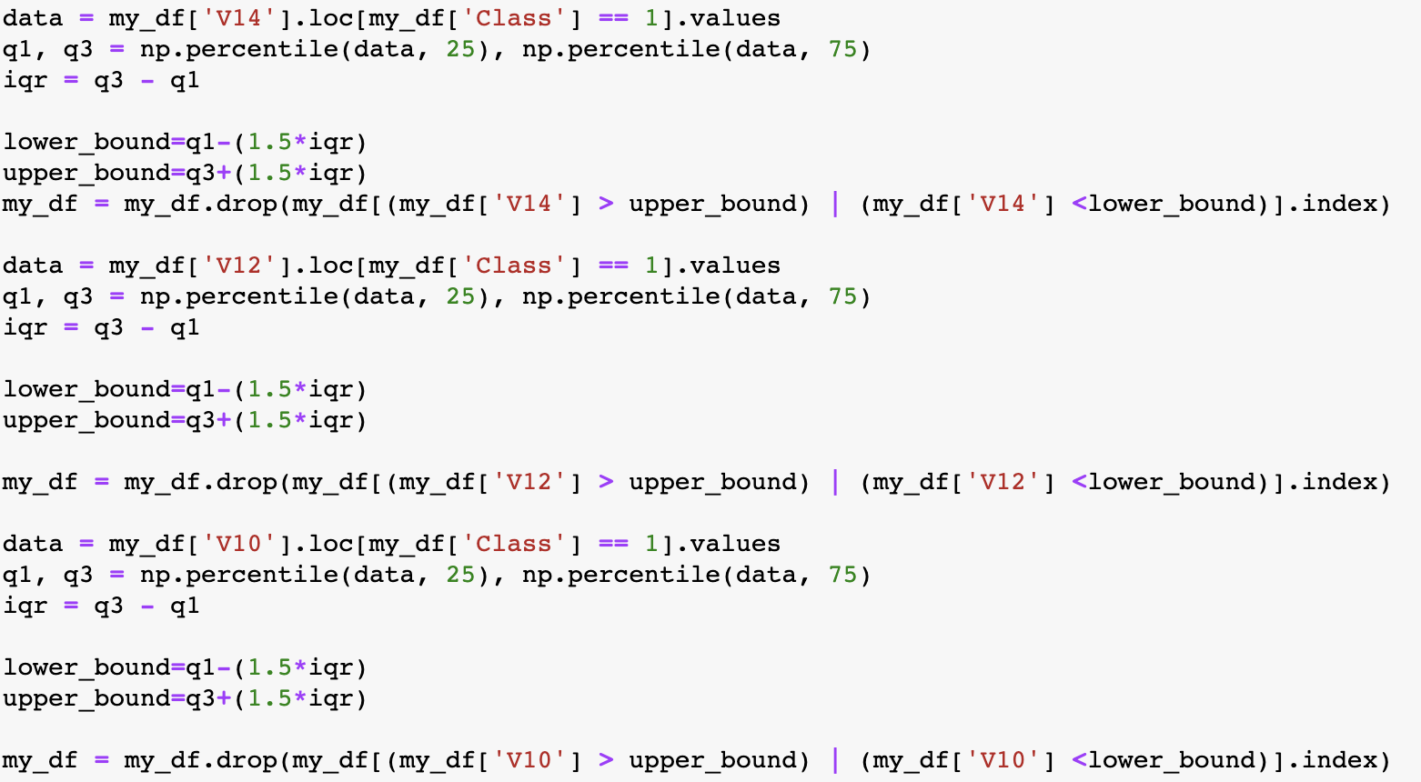
Data processing
Random undersampling to resample the data
Use IQR to delete those out liars which affect badly on our prediction

Slide 9
3
Credit Card Fraud Detection
Methodology

Slide 10

SVM Model
KNN Model
DNN Model
Random Forest, XGBoost, and Regression Models
Key Models

Slide 11
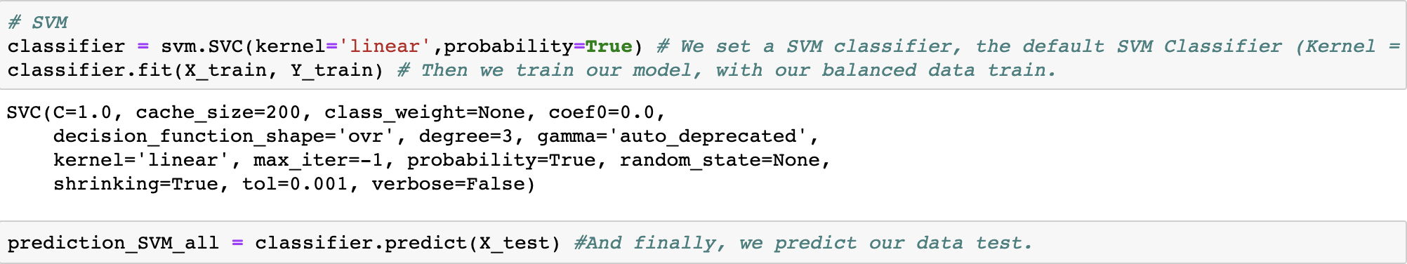
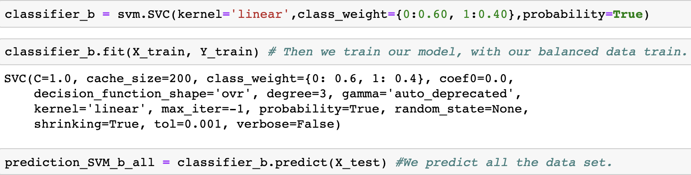
SVM model
Re-balanced class weigh

Slide 12
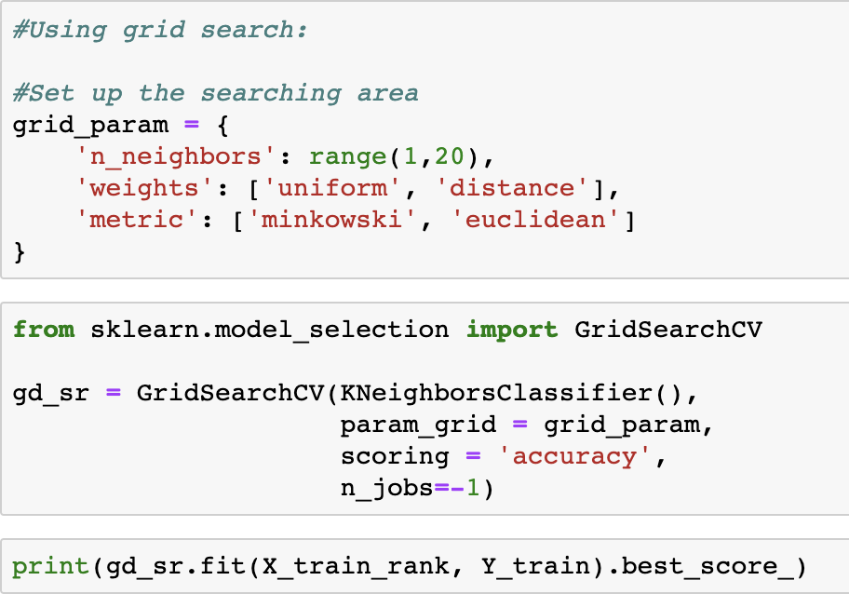
KNN model
With grid search hypermeter tuning:

Slide 13
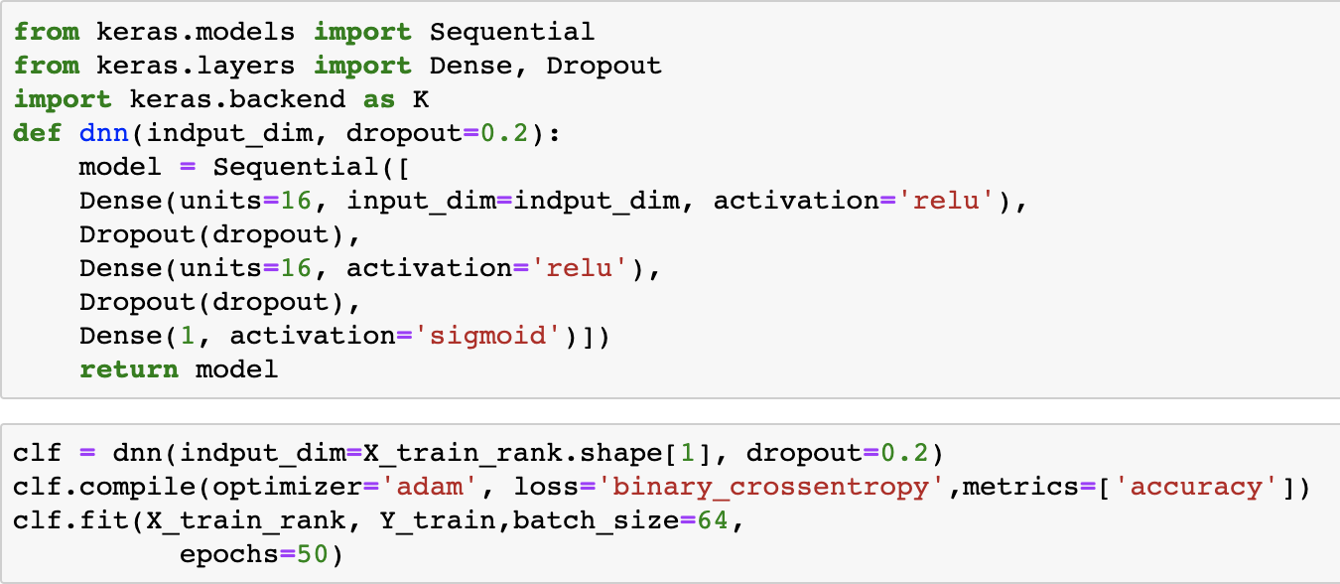
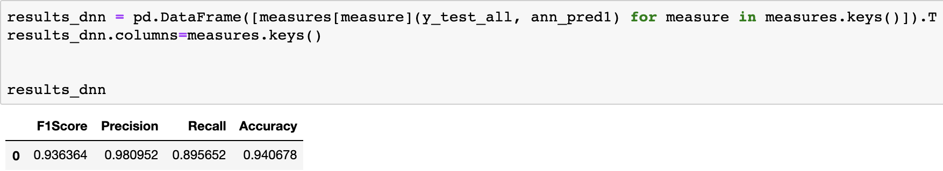
DNN model

Slide 14
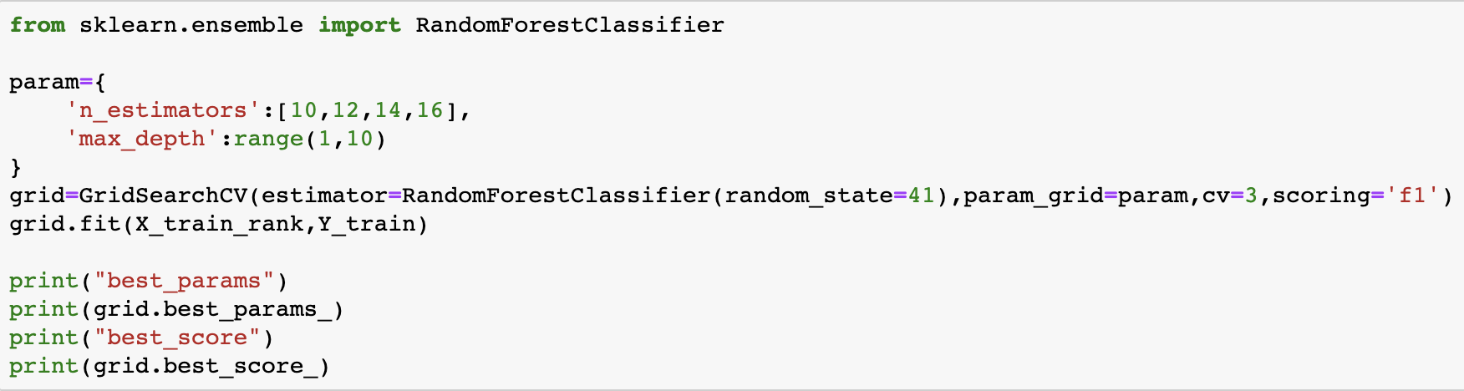
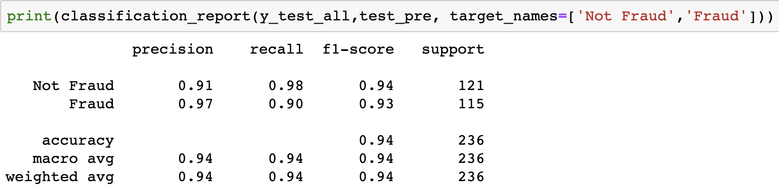
Random Forest

Slide 15
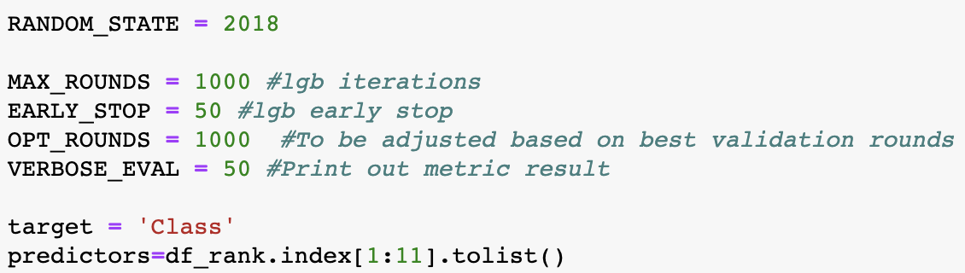
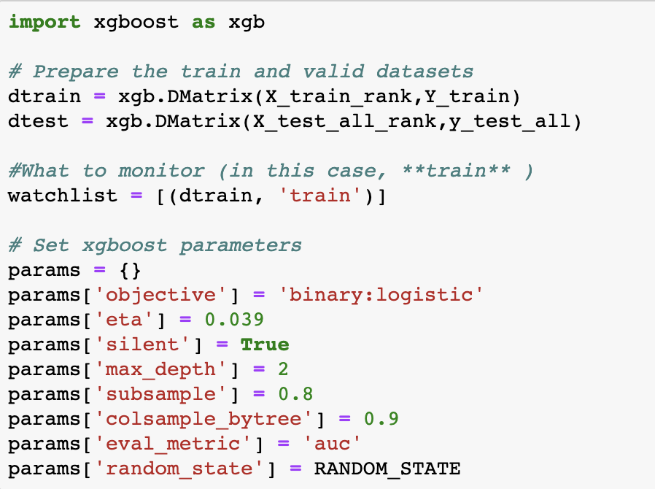
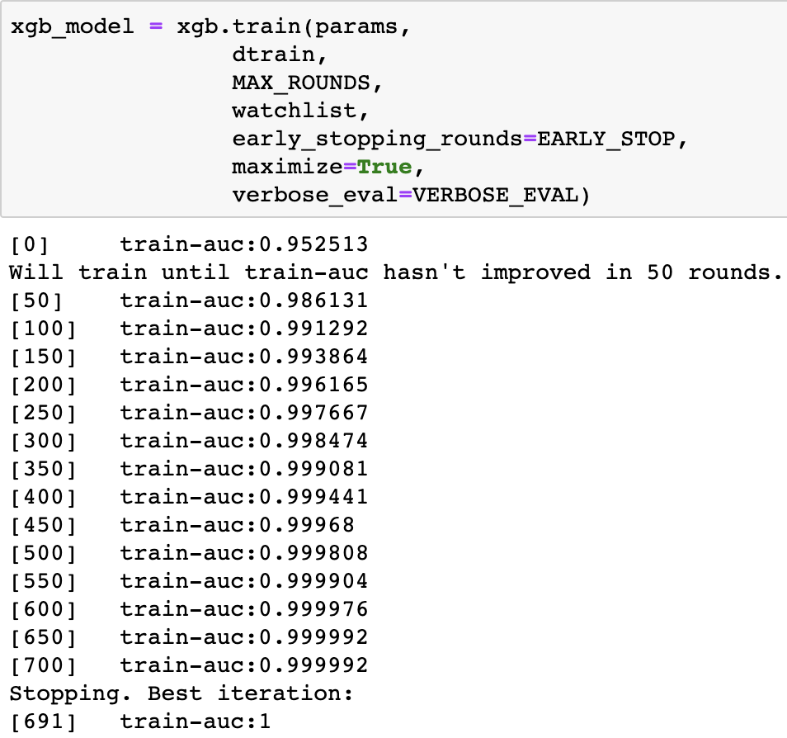
XGBoost

Slide 16
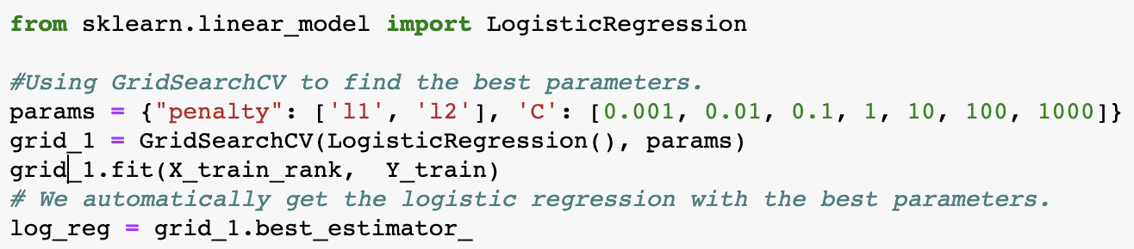
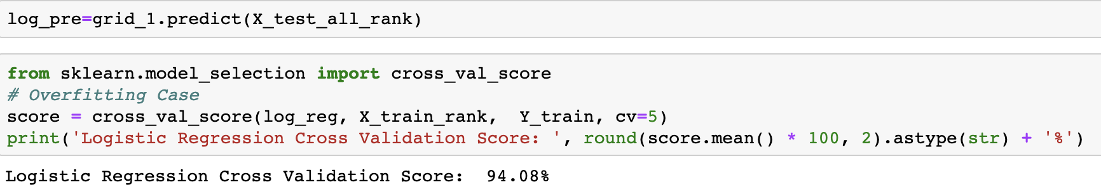
Logistics Regression

Slide 17
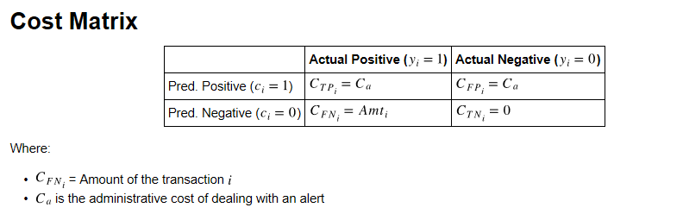
Cost-Sensitive learning
The idea behind cost-sensitive learning is to take the example dependent costs into account and make predictions that aim to minimize the overall costs instead of minimizing misclassifications.

Slide 18
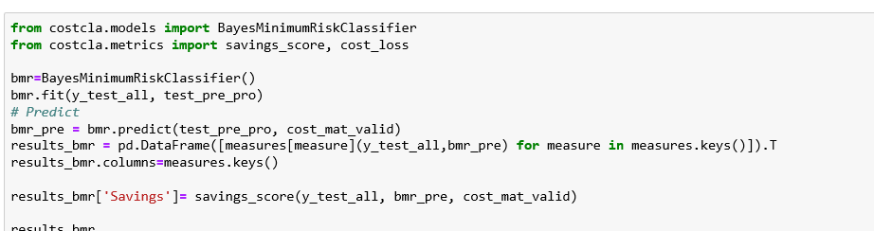
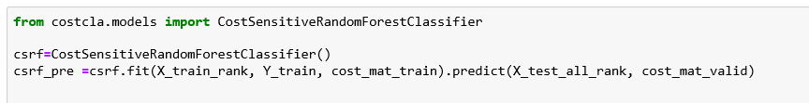
Bayes Minimum Risk (BMR)
The BMR classifier is a decision model based on quantifying tradeoffs between various decisions using probabilities and the costs that accompany such decisions.
Cost-Sensitive Random Forest (CSRF)
Introduce the costs during the estimation of the methods.

Slide 19
4
Credit Card Fraud Detection
Conclusion

Slide 20
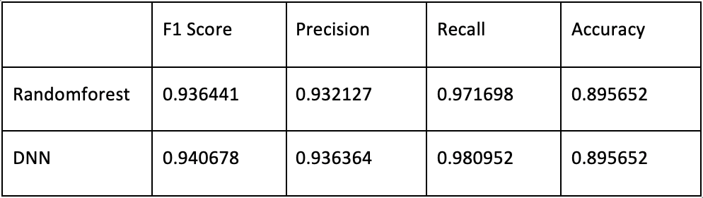
Results
F1 Score, Precision, Recall, Accuracy
Regarding f1 Score , precision, recall, accuracy:
Randomforest and DNN are better models.

Slide 21
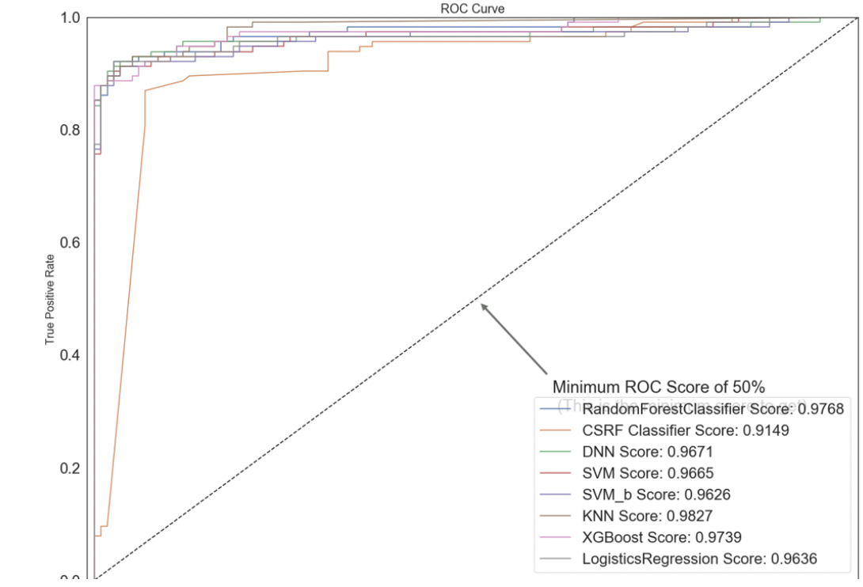
Results
ROC AUC (Resampling procedures allows a better use of ROC curves and AUC for predictive purposes)
Regarding Area under the ROC Curve:
RandomForest (0.9768), KNN (0.9827) and XGBoost (0.9739) are the better models which got roc curve scores above 0.97.

Slide 22
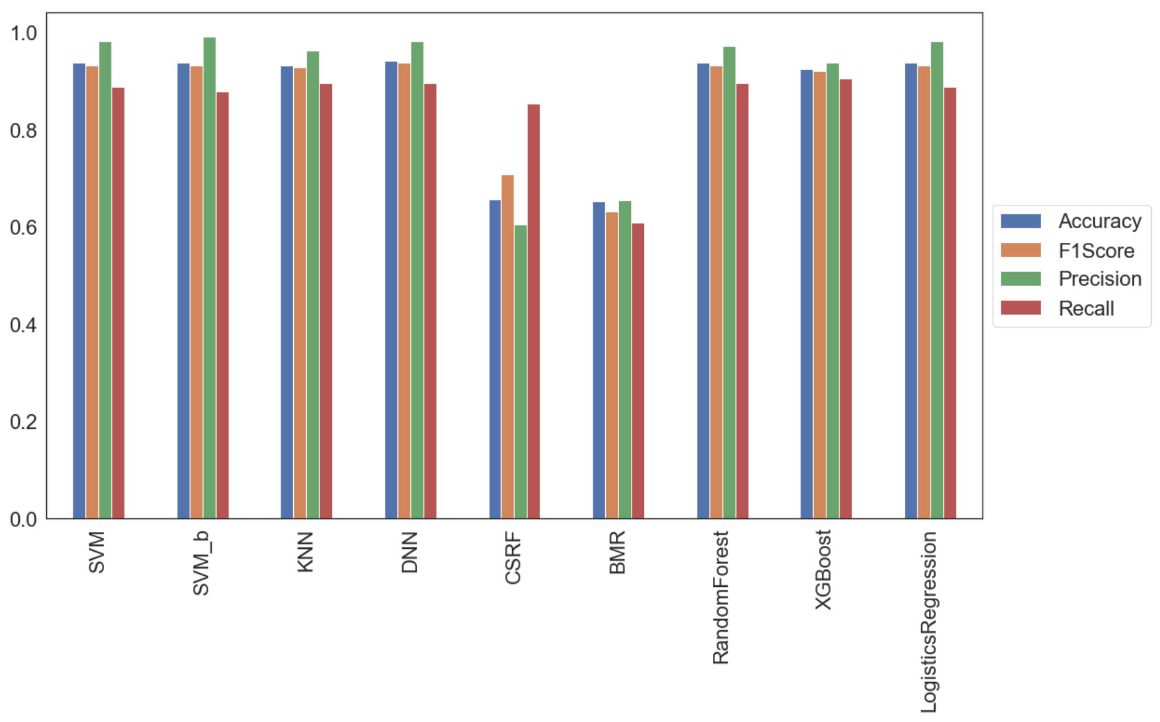
Conclusion
In conclusion, with all the models in comparison, Randomforest classifier seems to be the best model regarding all of the metrics we used with score of 97.68%.

Slide 23
THANKS

